Slide 1
Chapter 9 – Bit Operations (Part 2):
Bit Masks
Jihene Kaabi & Youssef Harrath

Slide 2




Why Bit Operations
There are assembly bitwise instructions for all standard Boolean operations AND, OR, XOR and NOT.
Bits are computed individually.
Examples:

Slide 3
Boolean Bitwise Instructions: Examples
Mov ax, 0C123h
and ax, 082F6h ; ax = C123 AND 82F6
or ax, 0E34Fh ; ax = 8022 OR E34F = E36F
xor ax, 036E9h ; ax = E36F XOR 36E9 = D586
not ax ; ax = NOT D586 = 2A79
= 8022h
1 | 1 | 0 | 0 | 0 | 0 | 0 | 1 | 0 | 0 | 1 | 0 | 0 | 0 | 1 | 1
AND
1 | 0 | 0 | 0 | 0 | 0 | 1 | 0 | 1 | 1 | 1 | 1 | 0 | 1 | 1 | 0
1 | 0 | 0 | 0 | 0 | 0 | 0 | 0 | 0 | 0 | 1 | 0 | 0 | 0 | 1 | 0

Slide 4
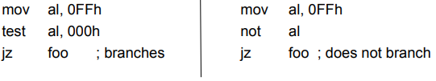
The test Instruction
The test instruction performs an AND, but dos not store the result. It only sets the FLAG bits.
Just like cmp does a subtraction but never stores its result.
Note that all Boolean bitwise instructions do set the FLAG bits except the NOT operation.
Example:
the result is zero, ZF will be set.

Slide 5
Uses of Bitwise Operations
Bitwise operations are useful to modify individual bits within data.
This is done via bit masks, i.e., constant (immediate) quantities with carefully chosen bits.
Example:
Say you want to “turn on” bit 3 of a 2-byte value (counting from right, with bit 0 being the least significant bit)
An easy way to do this is to OR the value with 0000000000001000, which is 8 in decimal
Say the value is stored in ax
You can simply execute the instruction:
or ax, 8 ; turns on bit 3 in ax

Slide 6
Uses of Bitwise Operations (cont.)
Easy to generalize
To turn on bits: use OR (with appropriate 1’s in the bit mask)
To turn off bits: use AND (with appropriate 0’s in the bit mask)
To flip bits: use XOR (with appropriate 1’s in the bit mask)

Slide 7
Bit Mask Operations: Exercise
Assume that EAX = 04F346BA2h. Write bit mask operations to:
Turn on the 4 leftmost bits of ax
Invert bit 22 of EAX
Find the 1’s complement of AX

Slide 8
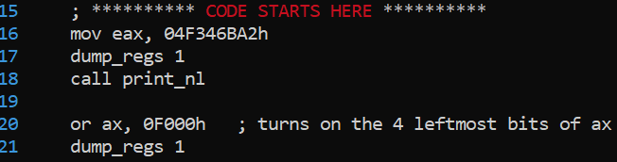
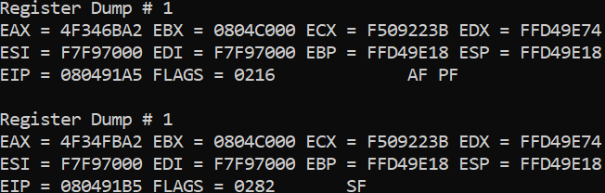
Bit Mask Operations: Exercise (Solution) (1)
Assume that EAX = 04F346BA2h. Write bit mask operations to:
Turn on the 4 leftmost bits of ax
OR AX, 0F000h
; EAX = 04F34FBA2h
Output:

Slide 9
Bit Mask Operations: Exercise (Solution) (2)
Assume that EAX = 04F346BA2h. Write bit mask operations to:
Invert bit 22 of EAX
EAX =0 4 F 3 4 6 B A 2
So, to invert bit 22 of EAX, we XOR EAX, 000400000h
bits
28--31 | 24--27 | 20--23 | 16--19 | 12--15 | 8--11 | 4--7 | 0--3
XOR
0011
0100
0111
EAX = 04F746BA2h

Slide 10
Bit Mask Operations: Exercise (Solution) (3)
Assume that EAX = 04F346BA2h. Write bit mask operations to:
Find the 1’s complement of AX
AX =06BA2h
To find the 1’s complement of AX, we XOR AX, 0FFFFh
EAX =04F34945Dh
0 | 1 | 1 | 0 | 1 | 0 | 1 | 1 | 1 | 0 | 1 | 0 | 0 | 0 | 1 | 0
XOR
1 | 1 | 1 | 1 | 1 | 1 | 1 | 1 | 1 | 1 | 1 | 1 | 1 | 1 | 1 | 1
1 | 0 | 0 | 1 | 0 | 1 | 0 | 0 | 0 | 1 | 0 | 1 | 1 | 1 | 0 | 1

Slide 11
Remainder of a Division by 2^{i}
The AND operation can also be used to find the remainder of a division by a power of two.
To find the remainder of a division by 2^{i}, AND the number with a mask equal to 2^{i}-1.
This mask will contain ones from bit 0 up to bit i-1. It is just these bits that contain the remainder.
The result of the AND will keep these bits and zero out the others.

Slide 12
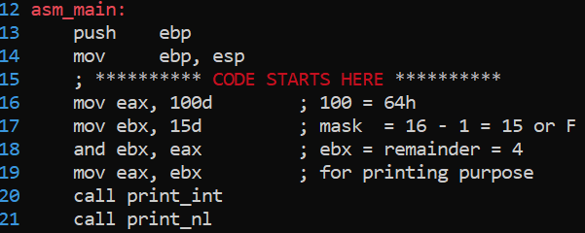

Remainder of a Division by 2^{i} (Example)
Let’s compute the remainder of the division of (100)₁₀ by 2⁴=(16)₁₀ (unsigned) by doing an AND with 2⁴-1=15.
The remainder when dividing 100 by 16 is 4.

Slide 13
Turning On a Specific Bit
Using the CL register it is possible to modify arbitrary bits of data.
Say you want to turn on a specific bit in some data, but that you don’t know which one before you run the program.
the index of the bit to turn on is contained in a register.
we need to build the bit mask “on the fly.”

Slide 14
Turning On a Specific Bit: Example (1)
Assuming that the index of the bit is initially in bl, and that we wish to turn on a bit in eax.
Assume bl = 5 and eax = (25)₁₀ = 0…00011001
mov cl, bl ; the bit index must be in cl
mov ebx, 1 ; create a number 0…01 and store it in ebx
left shift ebx cl times ; ebx = 0….0100000
OR eax, ebx
EAX = (57)₁₀
Sample output:
0 | … | 0 | 0 | 0 | 1 | 1 | 0 | 0 | 1
OR
0 | … | 0 | 0 | 1 | 0 | 0 | 0 | 0 | 0
0 | … | 0 | 0 | 1 | 1 | 1 | 0 | 0 | 1

Slide 15
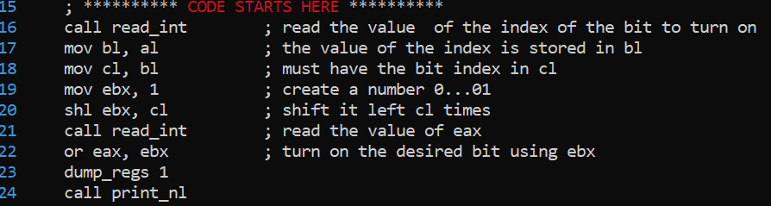
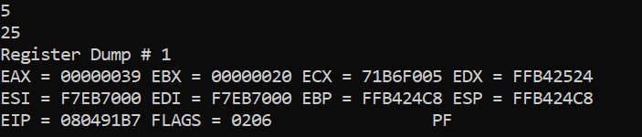
Turning On a Specific Bit: Example (2)
Assuming that the index of the bit is initially in bl, and that we wish to turn on a bit in eax.
Sample output:

Slide 16
Turning Off a Specific Bit: Example (1)
Turning a bit off requires one more instruction, to generate a bit mask that looks like 1...101..1
Assuming that the index of the bit is initially in bl, and that we wish to turn off a bit in eax.
Assume bl = 4 and eax = (25)₁₀ = 0…00011001
mov cl, bl ; the bit index must be in cl
mov ebx, 1 ; create a number 0…01 and store it in ebx
shl ebx, cl ; left shift ebx cl times ; ebx = 0…010000
not ebx ; take the complement ; ebx = 1…101111
and eax, ebx ; turn off the desired bit using ebx as a mask
EAX = (9)₁₀
Sample output:
0 | … | 0 | 0 | 0 | 1 | 1 | 0 | 0 | 1
and
1 | … | 1 | 1 | 1 | 0 | 1 | 1 | 1 | 1
0 | … | 0 | 0 | 0 | 0 | 1 | 0 | 0 | 1

Slide 17
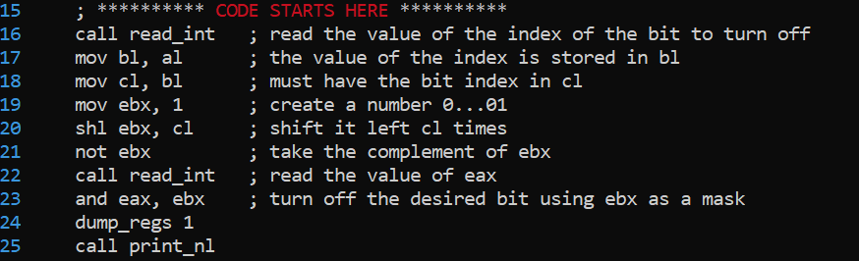
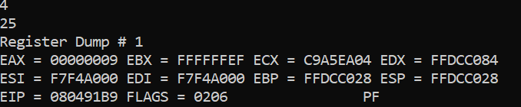
Turning Off a Specific Bit: Example (2)
Assuming that the index of the bit is initially in bl, and that we wish to turn off a bit in eax.
Sample output:

Slide 18
Avoiding Conditional Branching
Conditional branches greatly reduce the speed of processors
Essentially, one key to making processors go fast is to allow them to know what’s coming up next.
With conditional branches, the processor doesn’t know in advance whether the branch will be taken or not.
In many cases, we cannot avoid using conditional branches
It’s just in the nature of the computation
For instance, for a loop
But in some cases, it’s possible.

Slide 19
SETxx Instructions
The SETxx instructions provide a way to remove branches in certain cases.
These instructions set the value of a byte register or memory location to zero or one based on the state of the FLAGS register.
The characters after SET are the same characters used for conditional branches.
If the corresponding condition of the SETxx is true, the result stored is a one, if false a zero is stored.
For example,
setz al ; AL = 1 if ZF = 1, else 0

Slide 20
SETG Instruction
Say you want to set al to 0 if bx>cx or to 1 otherwise (all signed).
With the setg instruction you can save a conditional branch:
Similar instructions: setz, setng, sete, etc.
; without setg
mov al, 1 ; al = 1
cmp bx, cx ; compare
jng next ; jump if bx <= cx
mov al, 0 ; al = 0
next:
; with setg
mov al, 1 ; al = 1
cmp bx, cx ; compare
setg al, 0

Slide 21
Application1: Find the Maximum of two numbers (1)
Say we want to store into ecx the maximum of two (signed) numbers, one stored in eax and the other one in [num].
Here is a code to do this using conditional branch.
cmp eax, [num]
jge next ; conditional branch
mov ecx, [num]
jmp end
next:
mov ecx, eax
end:
Let’s rewrite this without a conditional branch!
Conditional branches are bad for performance.

Slide 22
Application 1: Find the Maximum of two numbers (2)
To avoid the conditional branch, one needs a SETxx instruction and clever bit masks.
We use a helper register, ebx, which we set to all zeros xor ebx, ebx
We compare the two numbers cmp eax, [num]
We set the value of bl to 0 or 1 depending on the result of the comparison setg bl
If eax > [num], ebx = 1 = (0...01)₂
If eax <= [num], ebx = 0 = (0...00)₂
We negate ebx (i.e., take 1’s complement and add 1)
neg ebx
If eax > [num] , ebx = (1...11)₂ = FFFFFFFFh
If eax <= [num] , ebx = (0...00)₂ = 0000000000h

Slide 23
Application 1: Find the Maximum of two numbers (3)
We now have:
eax contains one number, [num] contains the other number.
If eax > [num] (ebx = FFFFFFFFh), then eax will be the maximum
→ if we AND eax and ebx, we get eax.
If eax <= [num] (ebx = 00000000h), then [num] will be the maximum
→ if we AND [num] and NOT(ebx), we get [num].
So, if we compute ((eax AND ebx) OR ([num] AND NOT(ebx))) we get the maximum!
If eax is the maximum (ebx = FFFFFFFFh):
((eax AND ebx) OR ([num] AND NOT(ebx))) = eax OR (0...0) = eax
If [num] is the maximum (ebx = 00000000h):
((eax AND ebx) OR ([num] AND NOT(ebx))) = (0...0) OR [num] = [num]

Slide 24
Application 1: Find the Maximum of two numbers (4)
%include "/usr/local/share/csc314/asm_io.inc"
segment .data
prompt1 db "Enter the first number: ",0
prompt2 db "Enter the second number: ",0
outmesg1 db "The maximum is:",0
segment .bss
num resd 1
segment .text
global asm_main
asm_main:
push ebp
mov ebp, esp
; ********** CODE STARTS HERE **********
mov eax, prompt1
call print_string
call read_int
mov [num], eax ; the first number is in num
mov eax, prompt2
call print_string
call read_int ; the second number is in eax
xor ebx, ebx ; ebx = 0
cmp eax, [num] ; compare eax and [num]
setg bl ; bl = 1 if eax > [num], 0 otherwise
neg ebx ; take one’s complement + 1
mov ecx, ebx
and ecx, eax ; ecx = eax AND ebx
not ebx
and ebx, [num] ; ebx = [num] AND NOT(ebx)
or ecx, ebx ; ecx = (eax AND ebx) ) OR ([num] AND ; NOT(ebx))
mov eax, outmesg1
call print_string
mov eax, ecx
call print_int
call print_nl
; *********** CODE ENDS HERE ***********
mov eax, 0
mov esp, ebp
pop ebp
ret

Slide 25
Application 2: Counting Bits (1)
Section 3.6 of the book shows many methods for counting the number of bits on. These methods are shown in C. Let’s look at Method #1.
int count_bits (unsigned int data) {
int cnt = 0 ;
while (data != 0) {
data = data & (data – 1); //here where a bit is turned off
cnt ++;
}
return cnt;
}
In every iteration of the loop, one bit in data is turned off.
When all the bits are off (i.e. when data is zero), the loop stops.
The number of iterations required to make data zero is equal to the number of bits in the original value of data.

Slide 26
Application 2: Counting Bits (2)
Consider the general form of the binary representation of data and the rightmost 1 in this representation.
By definition, every bit after this 1 must be zero.
Now, what will be the binary representation of data - 1?
The bits to the left of the rightmost 1 will be the same as for data, but at the point of the rightmost 1 the bits will be the complement of the original bits of data.
For example:
data = xxxxx10000
data - 1 = xxxxx01111
where the x's are the same for both numbers.
When data is AND'ed with data - 1, the result will zero the rightmost 1 in data and leave all the other bits unchanged.

Slide 27
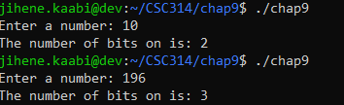
Application 2: Counting Bits (3)
%include "/usr/local/share/csc314/asm_io.inc"
segment .data
prompt1 db "Enter a number: ",0
outmesg1 db "The number of bits on is: ",0
segment .bss
num resd 1
segment .text
global asm_main
asm_main:
push ebp
mov ebp, esp
; ********** CODE STARTS HERE **********
mov eax, prompt1
call print_string
call read_int
xor ebx, ebx ; ebx is cnt
loop_start:
cmp eax, 0
jz loop_end ; if data == 0 goto loop_end
mov ecx, eax
sub ecx, 1 ; ecx := data - 1
and eax, ecx ; eax := data AND (data - 1 )
inc ebx ; cnt++
jmp loop_start
loop_end:
mov eax, outmesg1
call print_string
mov eax, ebx
call print_int
call print_nl
; *********** CODE ENDS HERE ***********
mov eax, 0
mov esp, ebp
pop ebp
ret
Sample output:

